Slide 1
Fixed vs Agentic workflow
By
Gowtham Sivasubramaniam

Slide 2
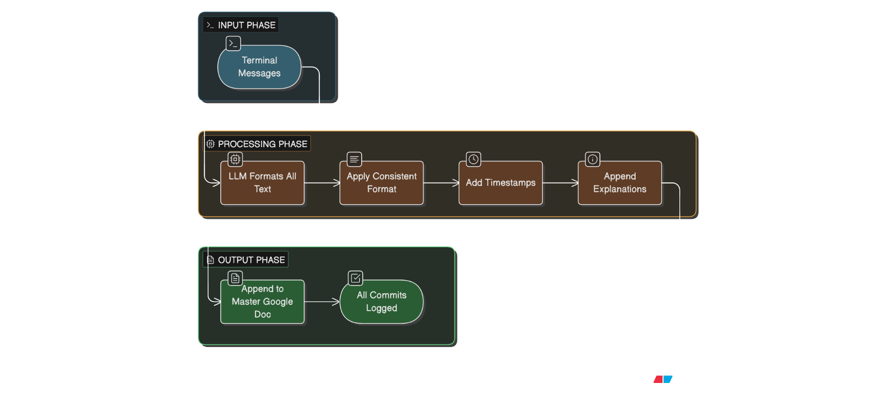
Fixed workflow for Organizing commands and outputs with reasoning.
Deterministic LLM → always formats and appends commends to a single Google Doc (no “judgment” or branching logic).

Slide 3
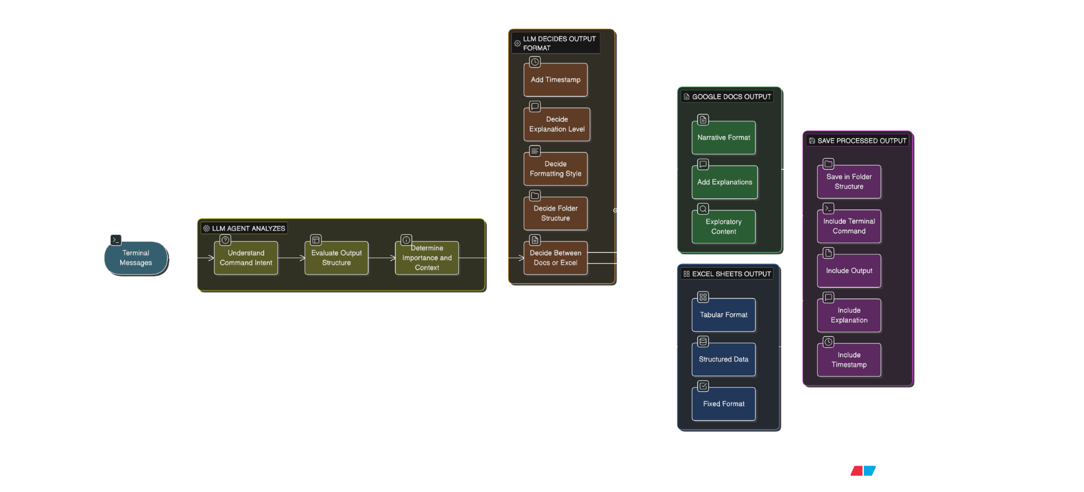
Agentic workflow for Organizing commands and outputs with reasoning.

Slide 4
Terminal Messages Input
Receives all terminal activity (commands + outputs) in real-time or batch.
Examples:
git commit -m "fix bug"
git log --graph
ls -la
npm install
This is the raw data source for the agent.

Slide 5
LLM Agent Analyzes The LLM reads each terminal message.
Determines:
Command intent – What is this command doing? (commit, log, install, test, etc.)
Output structure – Is the output tabular, structured, verbose, visual?
Context/importance – Is this a critical log, exploratory analysis, or routine operation?
Example:
git log --graph → exploratory visualization
git commit -m "fix bug" → structured record

Slide 6
LLM Decides
Based on the analysis, the agent chooses:
Docs vs Excel
Docs: narrative, exploratory, explanation-heavy
Excel: structured, tabular, repeatable format
Folder structure
Organize files by date or command type
e.g., /runs/2026-01-18/git_commits.xlsx

Slide 7
LLM Decides Formatting style
Narrative format for Docs
Columns/rows for Excel
Explanation level
Add reasoning for why this command was run
Add context for outputs
Timestamp
Record execution time
Maintain chronological order

Slide 8
Decision Branch
Agent routes the terminal message to either Google Docs or Excel based on its decision.
Google Docs
Narrative style
Adds explanations
Useful for exploratory commands (like git log, ls -la)
Excel Sheets
Structured format
Useful for repeatable, tabular data (like git commit history, test results)

Slide 9
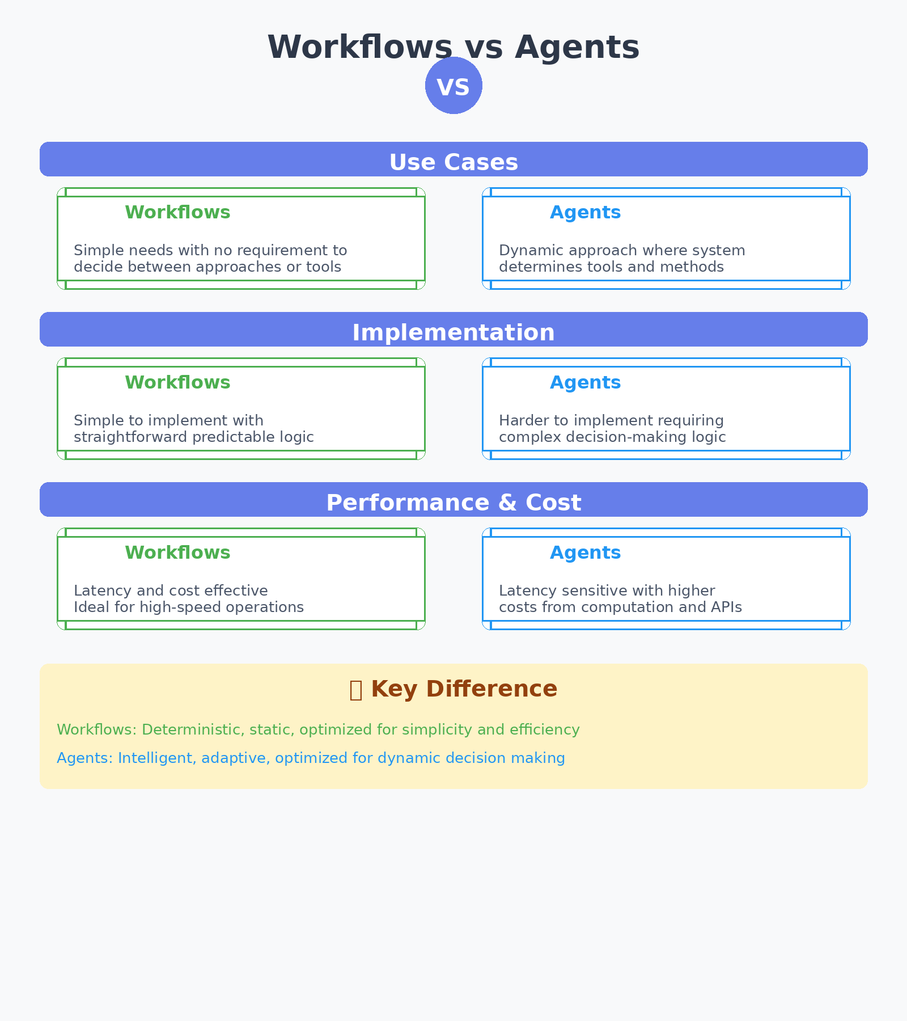
Best senario

